Slide 1
Sampling Distribution and Confidence Interval Estimation

Slide 2
Introduction to Sampling
Data are numerical values containing some information. Statistics is the science of data.
Statistical tools can be used on a data set to draw statistical inferences. These statistical inferences are in turn used for various purposes.
For example, the government uses such data for policy formulation for the welfare of the people, marketing companies use the data from consumer surveys to improve the company and to provide better services to the customer, etc.
Such data is obtained through sample surveys.
Sample surveys are conducted throughout the world by governmental as well as nongovernmental agencies.

Slide 3
Introduction to Sampling
For example, “National Sample Survey Organization (NSSO)” conducts surveys in India, “Statistics Canada” conducts surveys in Canada, agencies of United Nations like “World Health Organization (WHO), “Food and Agricultural Organization (FAO)” etc. conduct surveys in different countries.
Sampling theory provides the tools and techniques for data collection, keeping in mind the objectives to be fulfilled and the nature of the population.
There are two ways of obtaining the information
1. Sample surveys
2. Complete enumeration or census

Slide 4
Example
Sample surveys collect information on a fraction of the total population,
Whereas census collects information on the whole population.
Some surveys, e.g., economic surveys, agricultural surveys etc. are conducted regularly.
Some surveys are need-based and are conducted when some need arises, e.g., consumer satisfaction surveys at a newly opened shopping mall to see the satisfaction level with the amenities provided in the mall .

Slide 5
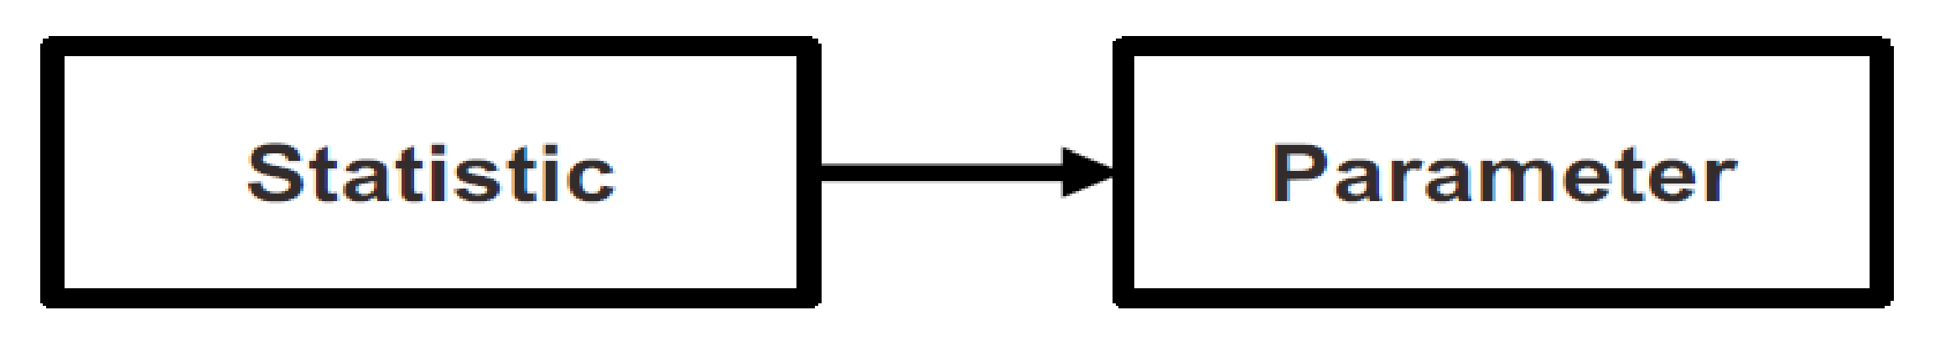
Problem and Solution
Problem The populations we wish to study are almost always so large that we are unable to gather information from every case.
Solution We choose a sample – a carefully chosen subset of the population – and use information gathered from the cases in the sample to generalize to the population.
Sample must be representative of the population representative:
The sample has the same characteristics as the population.
Statistics are mathematical characteristics of samples
Parameters are mathematical characteristics of populations
Statistics are used to estimate parameters.

Slide 6
Why Sampling?
Population considered for random experiment is too large and would cost too much and take too long.
e.g., when testing light bulbs to see how long they last, you take a bulb and leave it on until it burns out. You can't test all the bulbs this way, because their whole objective is to sell the bulbs, not burn them out.
It's not necessary to survey all cases: taking a sample yields a estimates that are accurate enough.
But sampling may introduce some error.
You didn't interview everybody, so certain opinions or combinations of opinions won't be represented in your data. When the population is very diverse, your sample can't include all the possible combinations of attributes that are found in the population.

Slide 7
Sampling Terminology
Population: A population is the collection of all items of interest to our study
Collection of all the sampling units in a given region at a particular point of time or a particular period.
For example, if you want to report 'what students think about online education', then the population is all Students.
If the production of wheat in a district is to be studied, then all the fields cultivating wheat in that district will constitute the population.
The total number of sampling units in the population is the population size, generally denoted by N.
The population size can be finite or infinite (N is large).

Slide 8
Sampling Terminology
Sample: some elements are selected from a population.
A sample should have the same characteristics as the population it is representing.
Gathering information about an entire population often costs too much or is virtually impossible. Instead, we use a sample of the population.
In the context of sample surveys, a collection of units like households, people, cities, countries etc. is called a finite population.
Census: when all elements are included, or complete count of population we call it a census. A census is a 100% sample, and it is a complete count of the population.
For example, in India, the census is conducted at every tenth year in which observations on all the persons staying in India is collected.

Slide 9
Sampling Terminology
Sampling unit: An element or a group of elements on which the observations can be taken is called a sampling unit. The objective of the survey helps in determining the definition of the sampling unit.
For example, if the objective is to determine the total income of all the persons in the household, then the sampling unit is a household. If the objective is to determine the income of any particular person in the household, then the sampling unit is the income of the particular person in the household. So the definition of sampling unit depends and varies as per the objective of the survey.
Elements: Individual cases or a single member of any given population.(usually, persons. Here each student)

Slide 10
Sampling Terminology
Representative sample: When all salient features of the population are present in the sample, then it is called a representative sample.
Every sample is considered as a representative sample.
For example, if a population has 30% males and 70% females, then we expect the sample to have nearly 30% males and 70% females.
Similarly, it is expected that a drop of blood will give the same information as all the blood in the body.
Sampling ratio: Size of sample divided by size of population.
Sampling frame: Specific list of items from which sample elements will be chosen.
Example, residents of a city may be listed in more than one frame - as per automobile registration as well as the listing in the telephone directory.
Online poll was done for favorite new paper. But actual result was different as Only city people owned mobiles and they were the ones who favored the result.

Slide 11
Sampling Terminology
Replacement: Sampling with replacement means that after you draw a item out of the sample space, you put it back and it can be chosen again. Sampling without replacement means that once you draw the name out, it is not available to be chosen again.
Bias: Systematic errors produced by your sampling procedure. For example, if you ask sample people whether they watch web series ? The percentage comes high (maybe because you ask your friends who really likes web series)

Slide 12
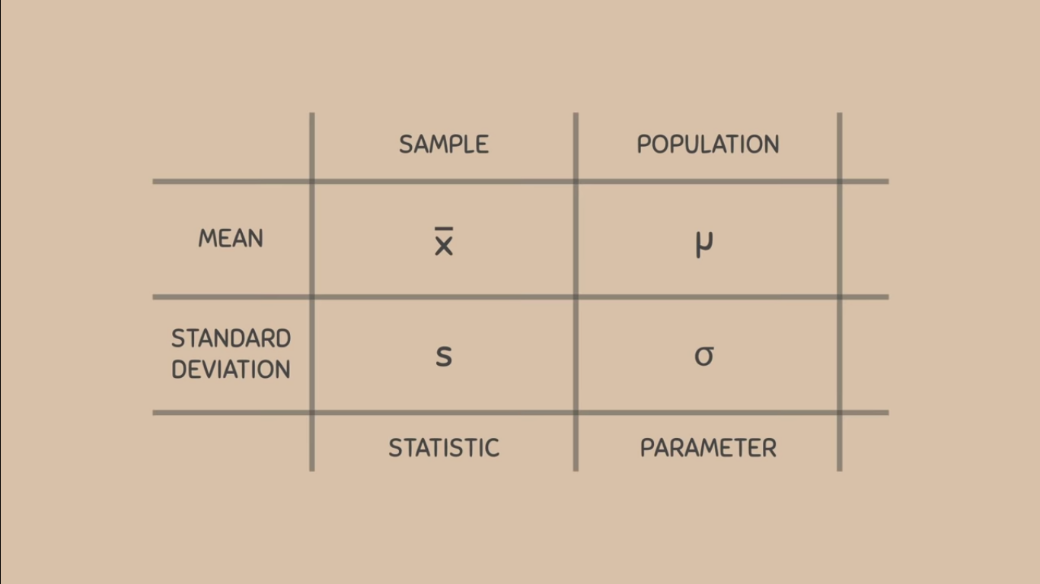
Sampling Terminology

Slide 13
Steps of sampling process
Identification of target population that is important for a given problem under study.
Decide the sampling frame.
Determine the sample size.
Sampling method.

Slide 14
Sampling Techniques
Probability sampling
Non probability sampling

Slide 15
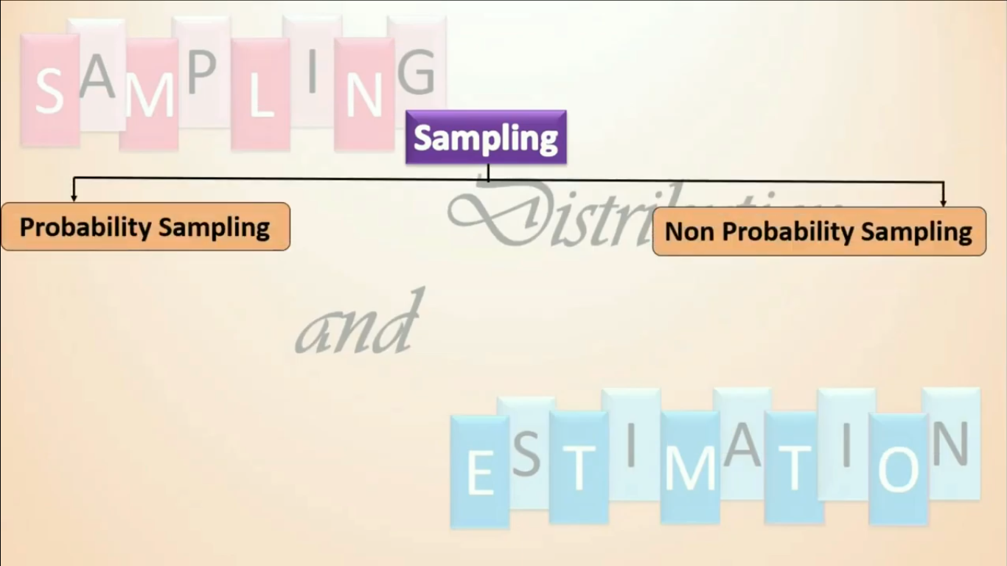
Sampling

Slide 16
Sampling Techniques : Probability sampling
The probability of an element’s (participant’s) being included in the sample can be specified.
Individual observations in the sample are selected according to probability distribution.
Assume that population has total of N cases, and we are interested in creating a sample of size n.
There are NCn [= N!/ {n! ×(N −n)!}] different ways for creating such a sample.

Slide 17
Sampling Techniques : Probability sampling
It is more difficult and expensive.
Useful when findings derived from the sample is to be generalized to the general population.
It is also known as random sampling or representative sampling.
In each form of random sampling, each member of a population initially has an equal chance of being selected for the sample.
The word random describes the procedure used to select elements (participants, cars, test items) from a population.

Slide 18
Sampling Techniques : Probability sampling
The samples can be drawn in two possible ways.
If random sampling is done with replacement. That is, once a member is picked, that member goes back into the population and thus may be chosen more than once.
In simple random sampling without replacement, a member of the population may be chosen only once. units once are chosen are not placed back in the population.

Slide 19
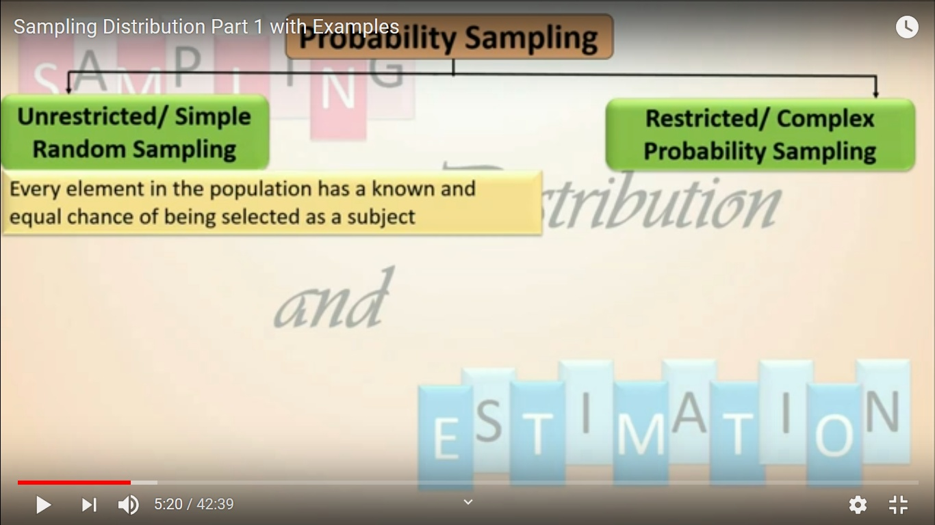
Probability Sampling

Slide 20
Probability Sampling Techniques
It is any sampling scheme in which the probability of choosing each individual is the same. These are also called random sampling.
In probability (random) sampling, you start with a complete sampling frame of all eligible individuals from which you select your sample.
All eligible individuals have a chance of being chosen for the sample, and you will be more able to generalize the results from your study.
more time-consuming and expensive, but much accurate.
1. Simple random sampling 2. Systematic sampling
3. Stratified sampling 4. Cluster sampling

Slide 21
Simple random sampling
In this case each individual is chosen entirely by chance and each member of the population has an equal chance, or probability, of being selected.
One way of obtaining a random sample is to give each individual in a population a number, and then use a table of random numbers to decide which individuals to include.

Slide 22
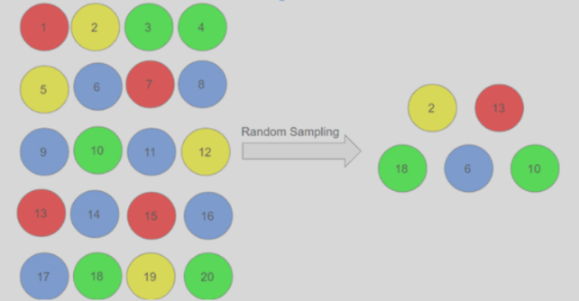
Simple random sampling

Slide 23
Simple random sampling
Advantages
Simplicity
Requires little prior knowledge of the population
Reduces selection bias
Disadvantages
Lower accuracy
Higher cost
Lower efficiency
Samples may be clustered spatially
Samples may not be representative of the feature attribute(s)

Slide 24
Systematic sampling
Individuals selected at regular intervals from sampling frame.
Intervals are chosen to ensure an adequate sample size.
If you need a sample size n from a population of size x, you should select every x/n^{th} individual for the sample.
For Example, suppose you have to do a phone survey.
Your phone book contains 20,000 residence listings.
You must choose 400 names for the sample.
Number the population 1–20,000.
Use a simple random sample to pick a number that represents the first name in the sample.
Then choose every fiftieth name thereafter until you have a total of 400 names (you might have to go back to the beginning of your phone list).

Slide 25
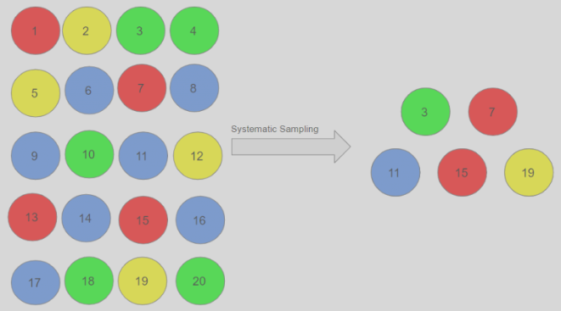
Systematic sampling

Slide 26
Systematic sampling
Advantages
Greater efficiency
Lower cost
Disadvantages
Lower precision
it may also lead to bias

Slide 27
Stratified Sampling
In this method, the population is first divided into subgroups (or strata) who all share a similar characteristic and then take a proportionate number from each stratum.
For example, you could stratify (group) your college population by department and then choose a proportionate simple random sample from each stratum (each department) to get a stratified random sample.

Slide 28
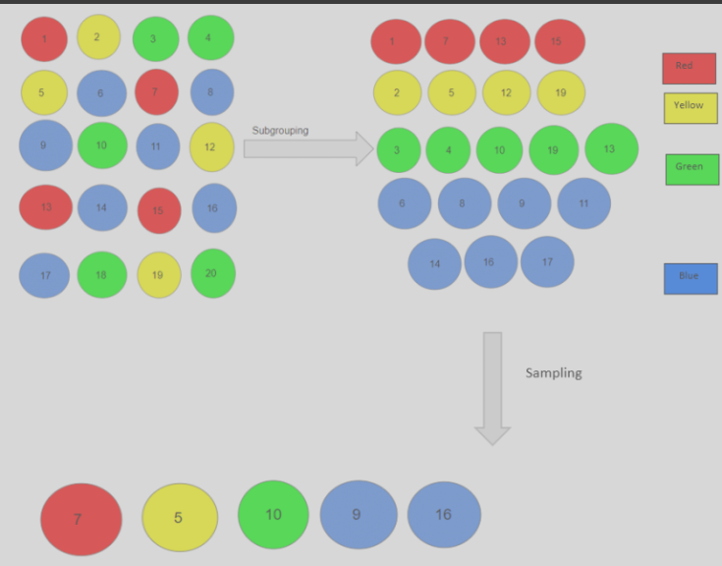
Stratified Sampling

Slide 29
Stratified Sampling
Advantages
Higher accuracy
Lower cost
Low bias
Disadvantages
it requires knowledge of the appropriate characteristics of the sampling frame
The existing knowledge used to construct strata may be flawed.

Slide 30
Cluster Sampling
Subgroups of the population are used as the sampling unit, rather than individuals.
The population is divided into subgroups, known as clusters, which are randomly selected to be included in the study.
All the members from these clusters are in the cluster sample.
In single-stage cluster sampling, all members of the chosen clusters are then included in the study.
In two-stage cluster sampling, a selection of individuals from each cluster is then randomly selected for inclusion. Clustering should be taken into account in the analysis.

Slide 31
Cluster Sampling
For example, if you randomly sample four departments from your college population,
the four departments make up the cluster sample.
Divide your college faculty by department.
The departments are the clusters.
Number each department, and then choose four different numbers using simple random sampling.
All members of the four departments with those numbers are the cluster sample.

Slide 32
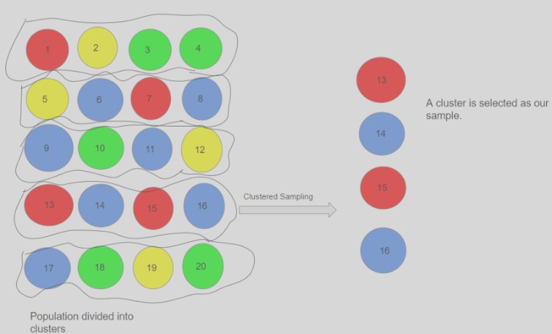
Cluster Sampling

Slide 33
Cluster Sampling
Advantages
Greater efficiency
Lower cost
Disadvantages
Lower precision
Higher bias

Slide 34
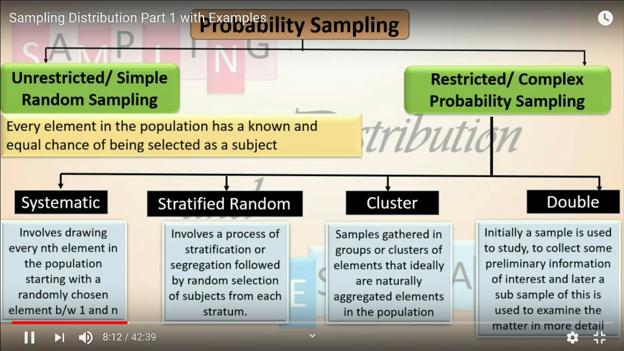

Slide 35
Sampling Techniques :
Non Probability sampling
There is no way of estimating the probability of an element’s being included in a sample.
The selection of units in the sample from the population is not governed by the probability laws.
For example, the units are selected on the basis of the personal judgment of the surveyor.
The persons volunteering to take some medical test or to drink a new type of coffee also constitute the sample on non-random laws.

Slide 36
Non Probability Sampling Techniques
you do not start with a complete sampling frame, so some individuals have no chance of being selected.
Consequently, you cannot estimate the effect of sampling error and there is a significant risk of ending up with a non-representative sample which produces non-generalisable results.
However, non-probability sampling methods tend to be cheaper and more convenient, and they are useful for exploratory research and hypothesis generation.
Convenience sampling
Quota sampling
Judgement (or Purposive) Sampling
Snowball sampling

Slide 37
Convenience sampling
Participants are selected based on availability and willingness to take part.
Useful results can be obtained, but the results are prone to significant bias, because those who volunteer to take part may be different from those who choose not to (volunteer bias), and the sample may not be representative of other characteristics.
It involves using results that are readily available.
For example, a computer software store conducts a marketing study by interviewing potential customers who happen to be in the store browsing through the available software.
Advantages : Easiest method of sampling

Slide 38
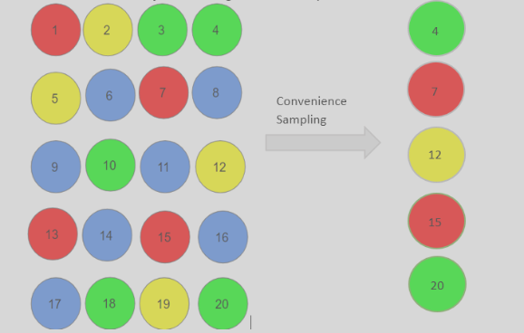
Convenience sampling

Slide 39
Quota sampling
This method of sampling is often used by market researchers. Interviewers are given a quota of subjects of a specified type to attempt to recruit.
Ideally the quotas chosen would proportionally represent the characteristics of the underlying population.
Advantages
Relatively straightforward and potentially representative
Disadvantages
The chosen sample may not be representative of other characteristics that weren’t considered

Slide 40
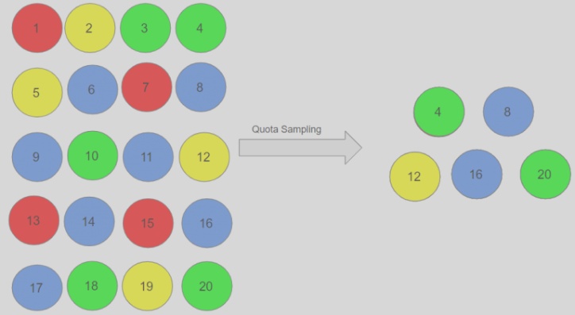
Quota sampling

Slide 41
Judgment (or Purposive) Sampling
Also known as selective, or subjective, sampling, this technique relies on the judgement of the researcher when choosing who to ask to participate.
In other words, researchers choose only those people who they deem fit to participate in the research study. Judgmental or purposive sampling is not a scientific method of sampling,
This approach is often used by the media when canvassing the public for opinions and in qualitative research.
Advantages
Time-and cost-effective to perform
Disadvantages
Volunteer bias, it is also prone to errors
Will not necessarily be representative

Slide 42
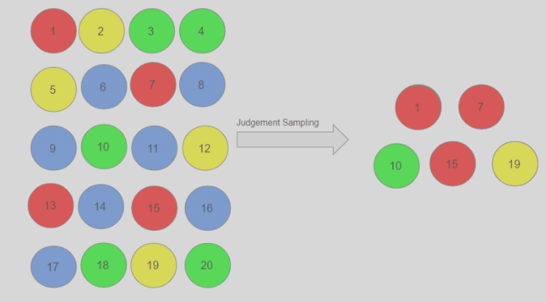
Judgment (or Purposive) Sampling

Slide 43
Snowball sampling
Commonly used in social sciences when investigating hard-to-reach groups. Existing subjects are asked to nominate further subjects known to them, so the sample increases in size like a rolling snowball.
Advantages
Effective when a sampling frame is difficult to identify
Disadvantages
Selection bias

Slide 44
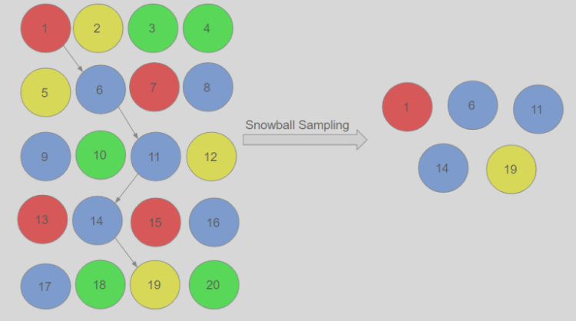
Snowball sampling

Slide 45
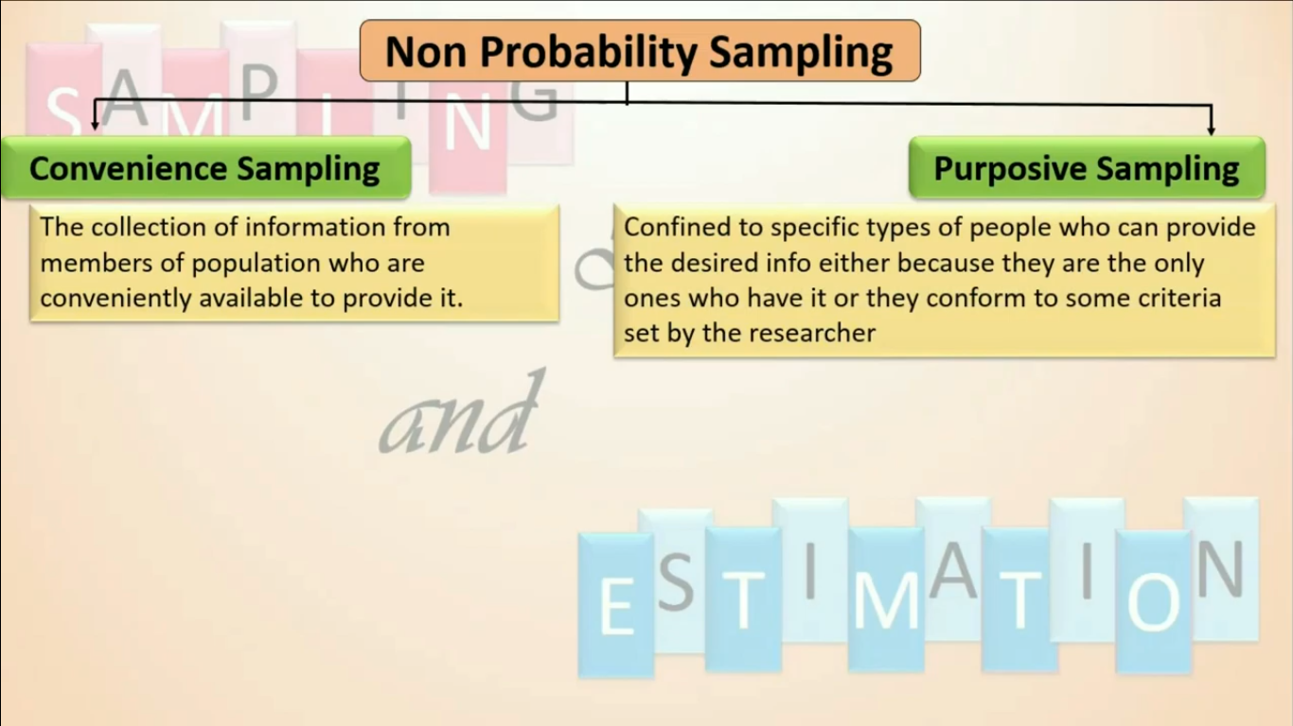

Slide 46
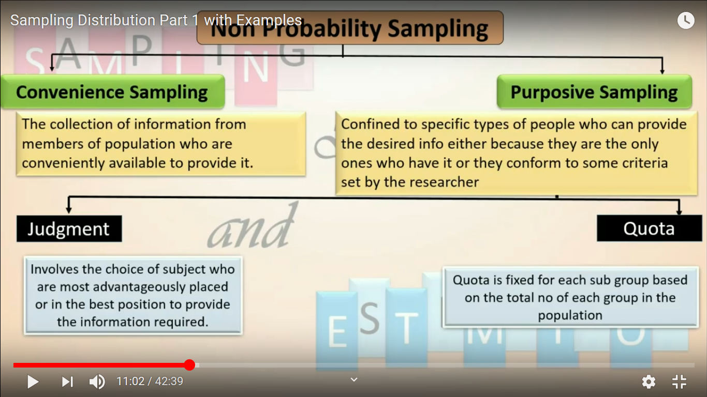

Slide 47
Examples
What kind of sampling would you expect was used if the sample group was composed of 5 yellow, 3 green, 4 red, and 6 blue members, and the population included 48 blue, 32 red, 24 green, and 40 yellow members?
Since the sample group contains exactly 1/8 as many members of each color as the entire population, it is reasonable to suspect that a stratified sampling was used.
What type(s) of sampling method(s) might be most appropriate for approximating the number of golden fish in a 25-mile section of river?
A 25-mile-long section of river is likely to include a number of different types of ecosystems that each would harbor a different density of fish. In order to get a good sample, a multi-stage sampling method comprised of a stratified sample of different ecosystems followed by a random sampling of fish in each ecosystem would probably be a good choice.

Slide 48
Examples
Would you reasonably expect bias to have affected a sample composed of 75% Toyota vehicles in a study of the most common cars in large U.S. cities?
Although Toyota is a very popular vehicle manufacturer, 75% is an extremely high percentage of vehicles in a large city (reasonable estimates put Toyota somewhere between 25 and 30 percent). Such a huge number would definitely suggest sample bias.
Would a random sampling of students be the most appropriate method of sampling for a study of the most enjoyable after-school club in a large public school?
Probably not, since a random sampling would likely include a large number of students who either have no opinion or have no experience with any after school clubs. More accurate results would be obtained by a multi-stage sample that first identified club members, and then randomly selected representatives from them.

Slide 49
Examples
What might you conjecture about a study that claims 100% of respondents preferred “Super Sweet and Crunchy” cereal over “Super Duper Sweet” cereal
There are a number of reasonable specific conjectures we might make, most related to inaccurate sampling methodology. Perhaps the sample was chosen from employees of the “Super Sweet and Crunchy” cereal company, perhaps respondents were offered a reward for choosing one option over the other, perhaps there was only a single member of the sample group or the “study” didn’t include milk for the other cereal, or didn’t offer samples of “Super Duper Sweet” to respondents at all.

Slide 50
Statistics and Parameters

